Slide 1
Bugs overview

Slide 2
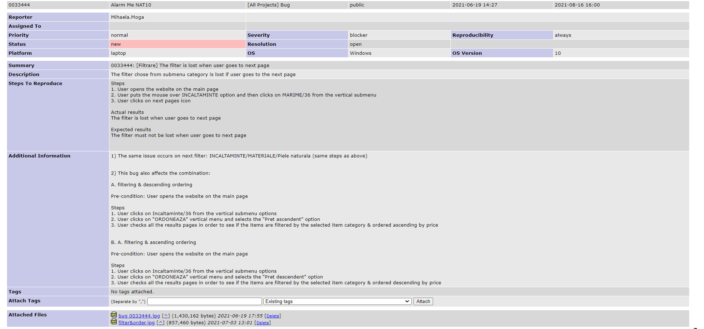
Bug 33444 – severity: blocker

Slide 3
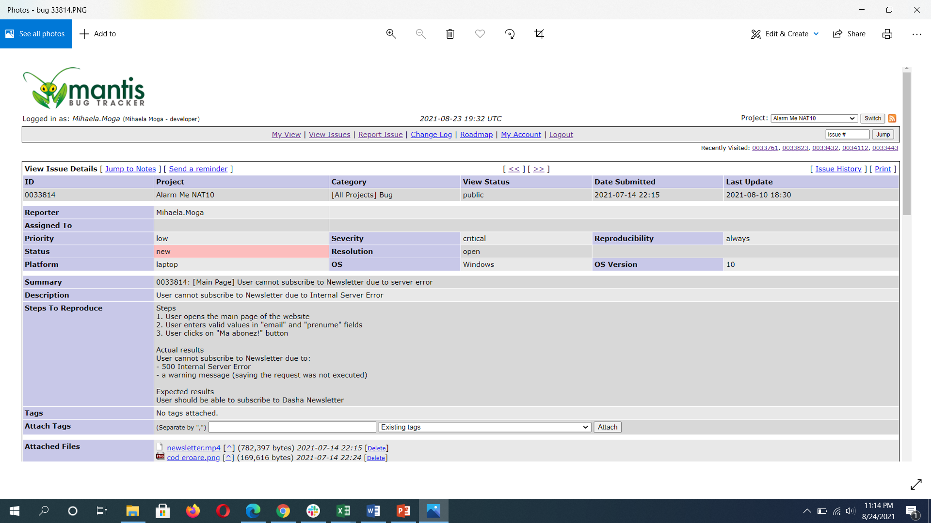
Bug 33814 – severity: critical

Slide 4
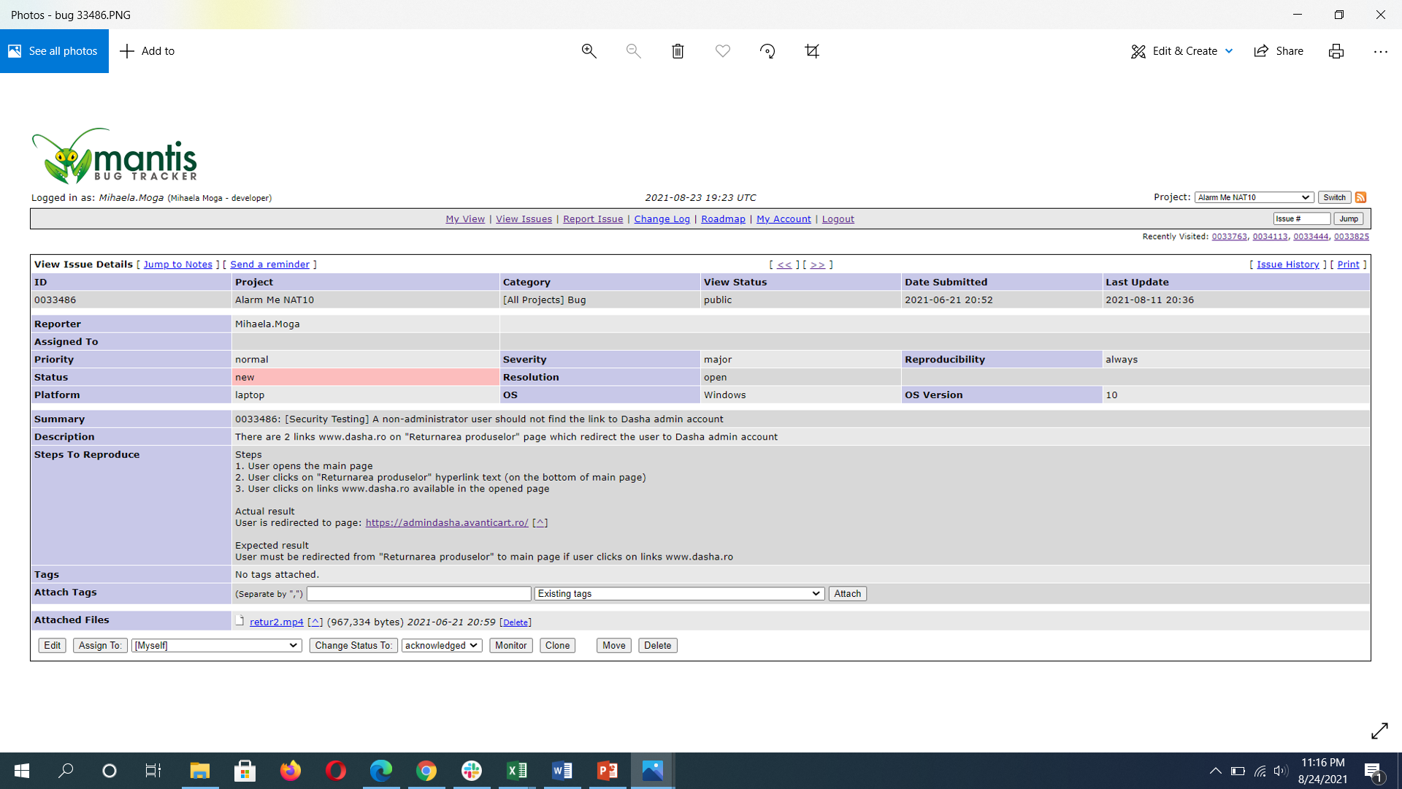
Bug 33486 – severity: major

Slide 5
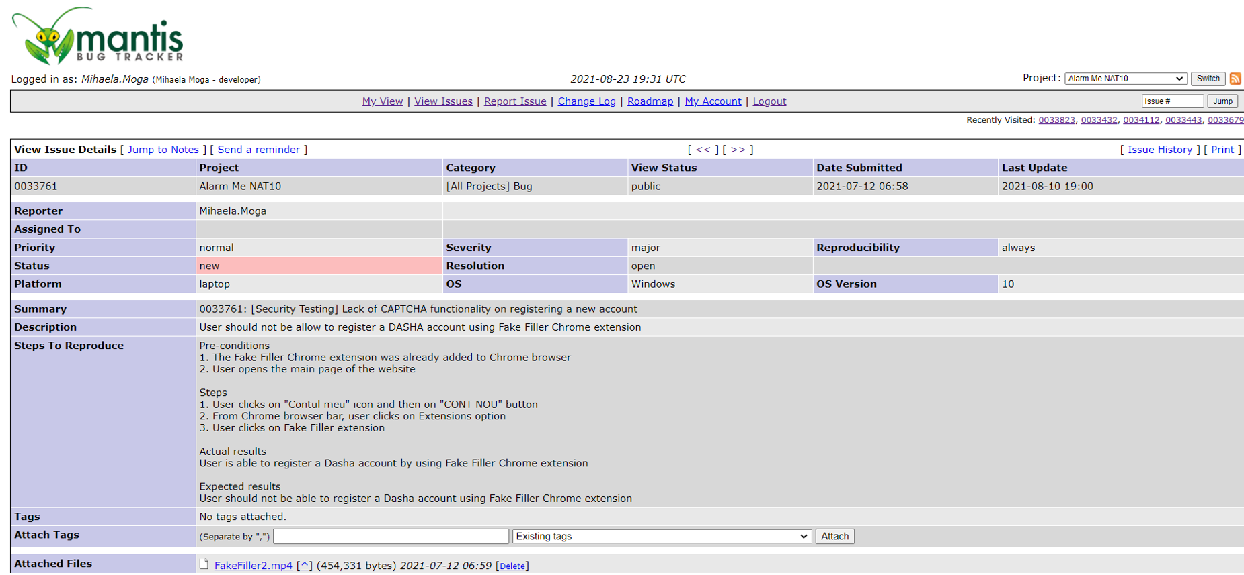
Bug 33761 – severity: major

Slide 6
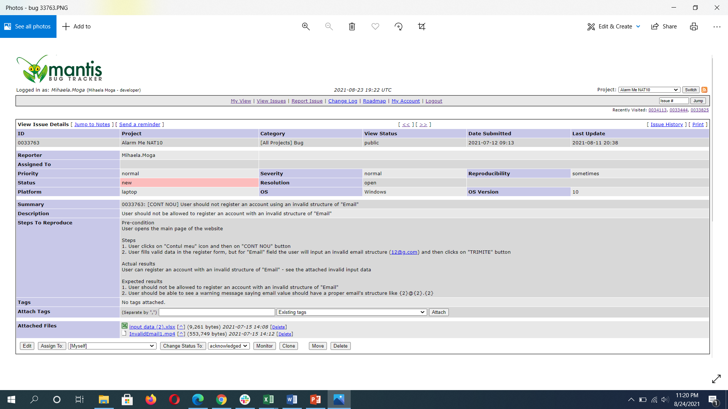
Bug 33763 – severity: normal

Slide 7
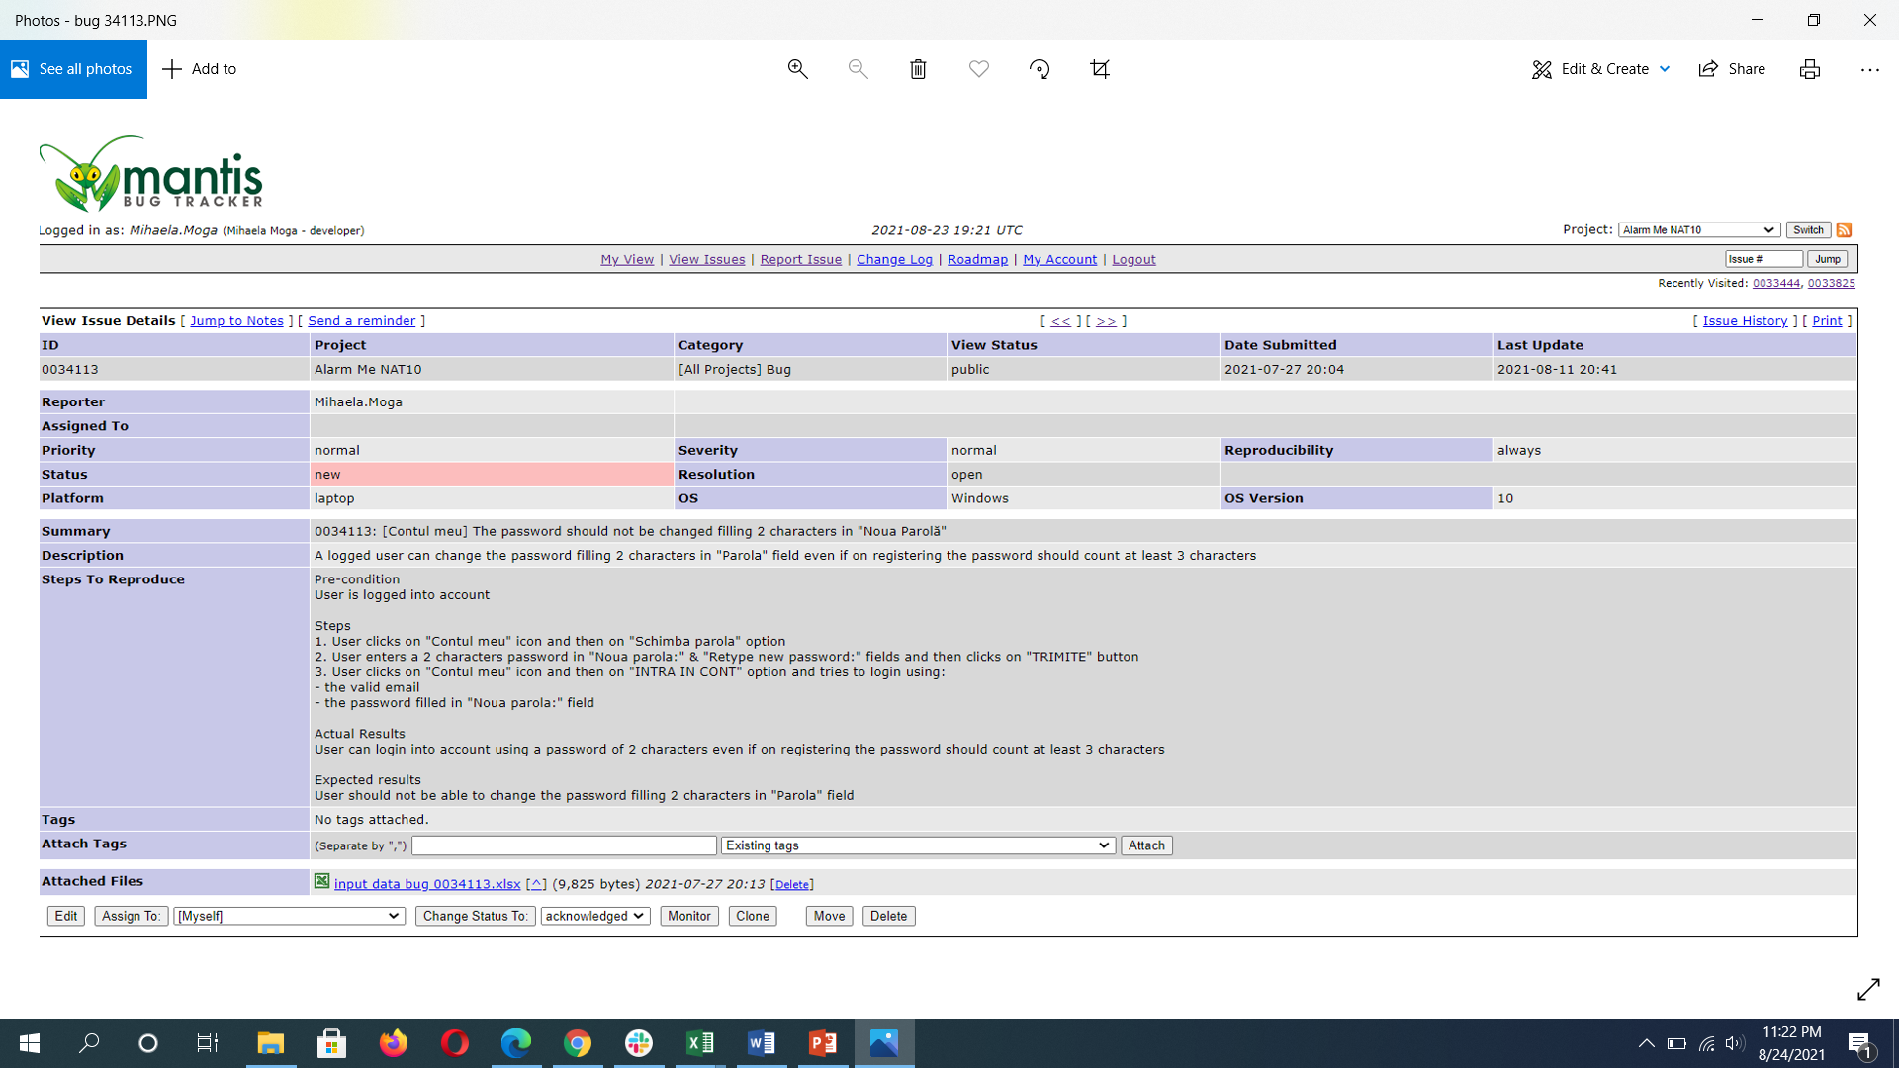
Bug 34113 – severity: normal

Slide 8
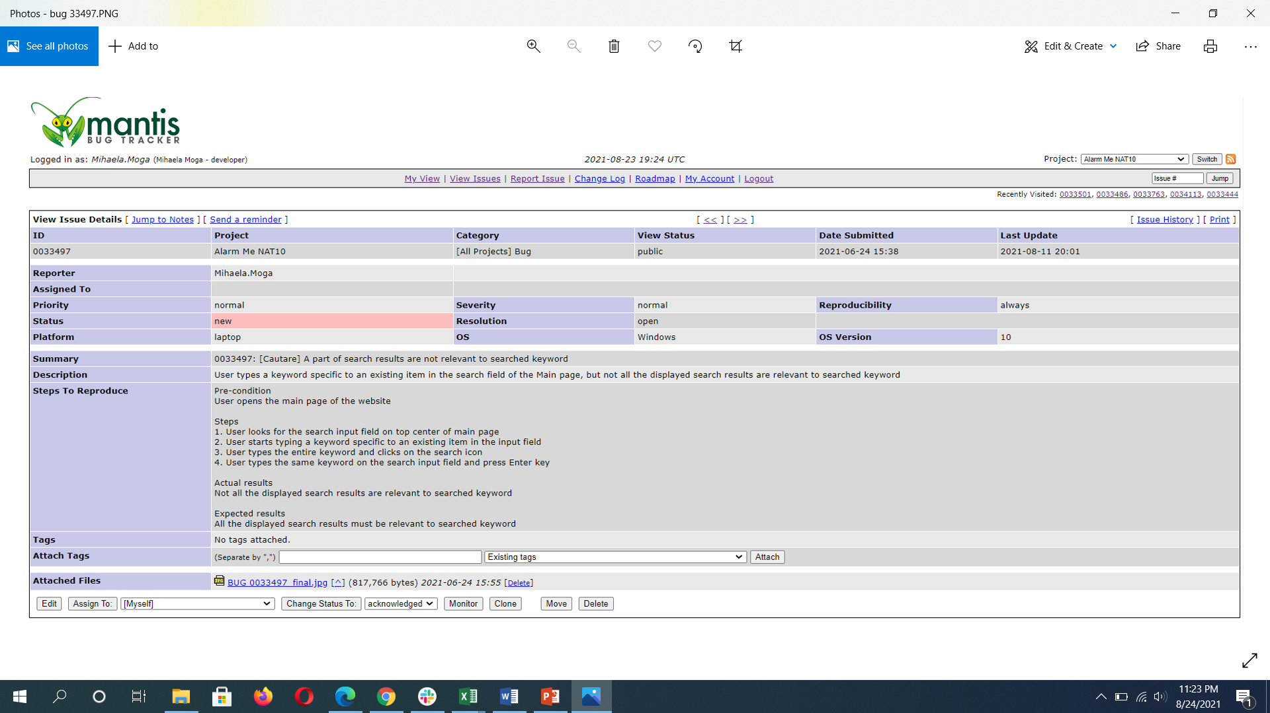
Bug 33497 – severity: normal

Slide 9
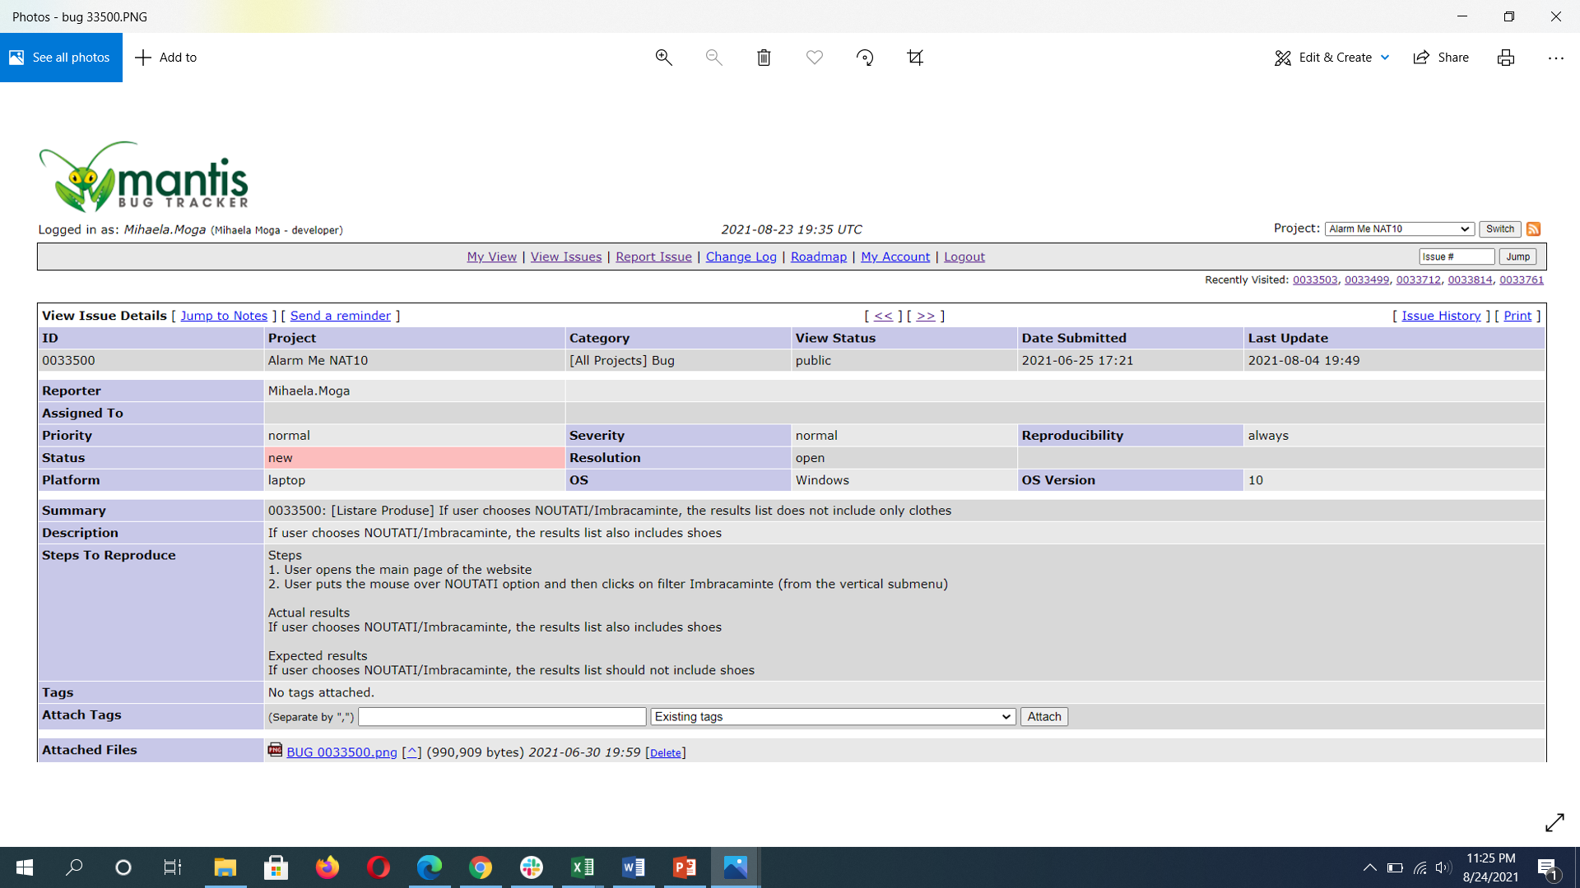
Bug 33500 – severity: normal

Slide 10
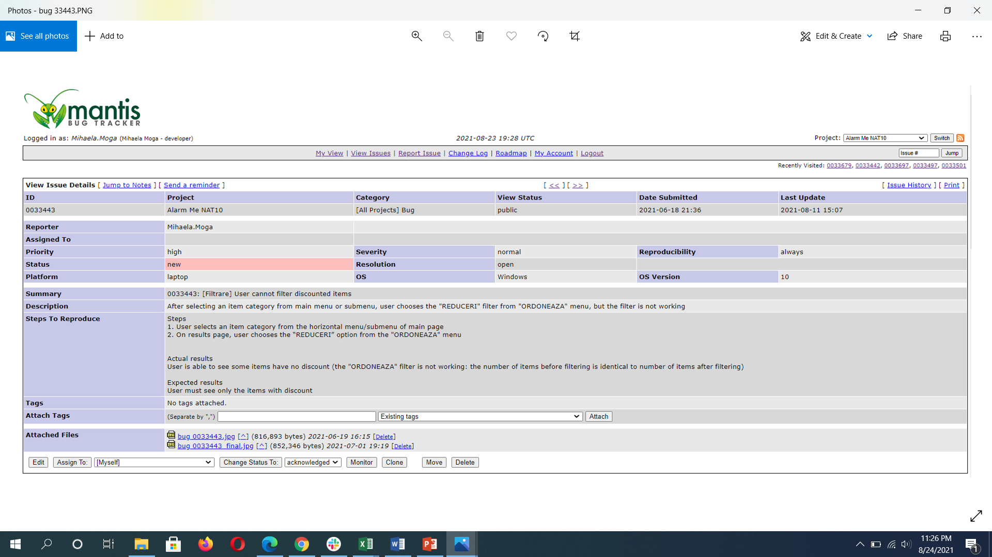
Bug 33443 – severity: normal

Slide 11
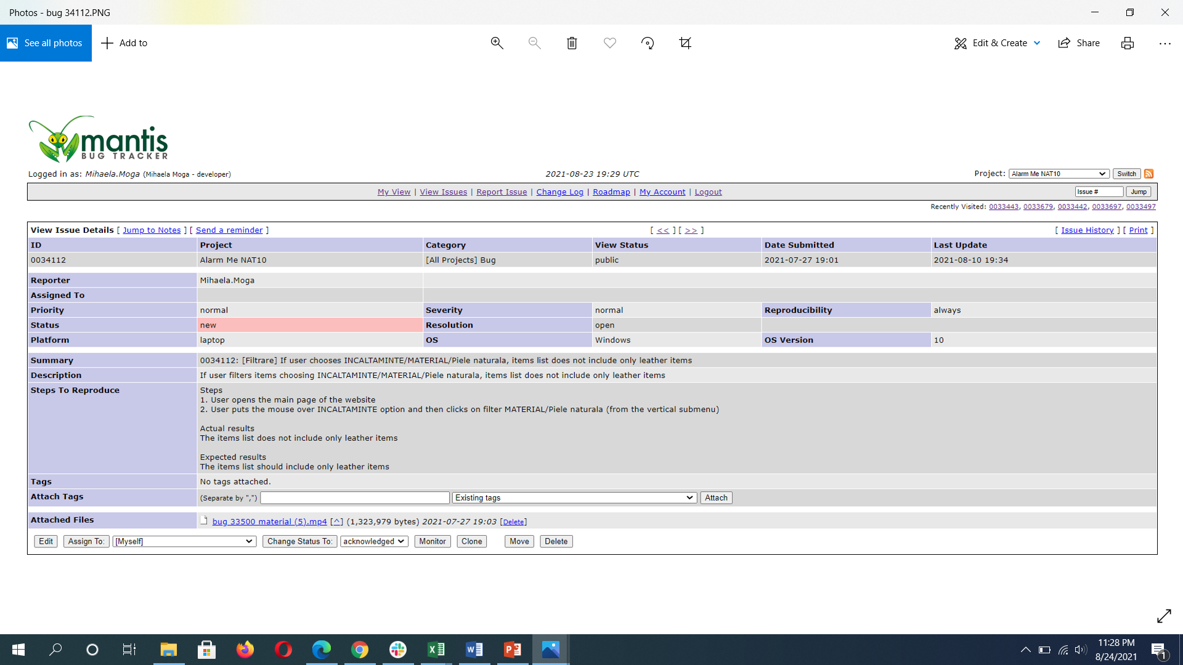
Bug 34112 – severity: normal

Slide 12
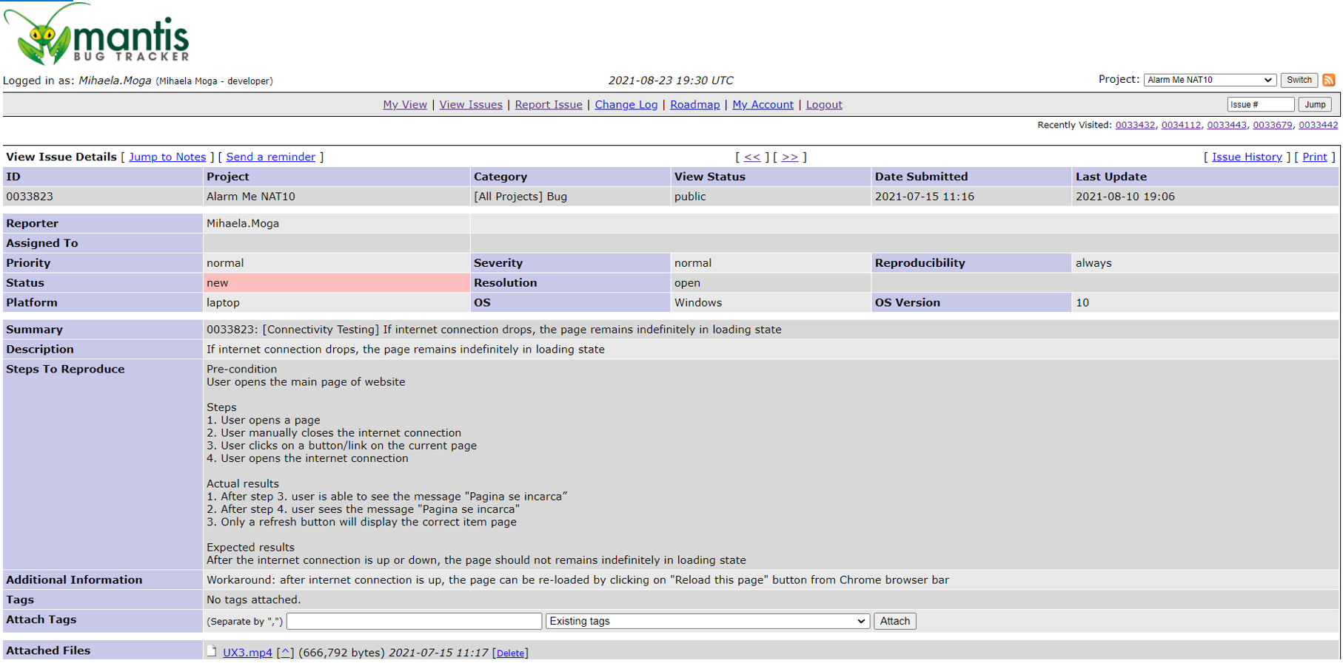
Bug 33823 – severity: normal

Slide 13
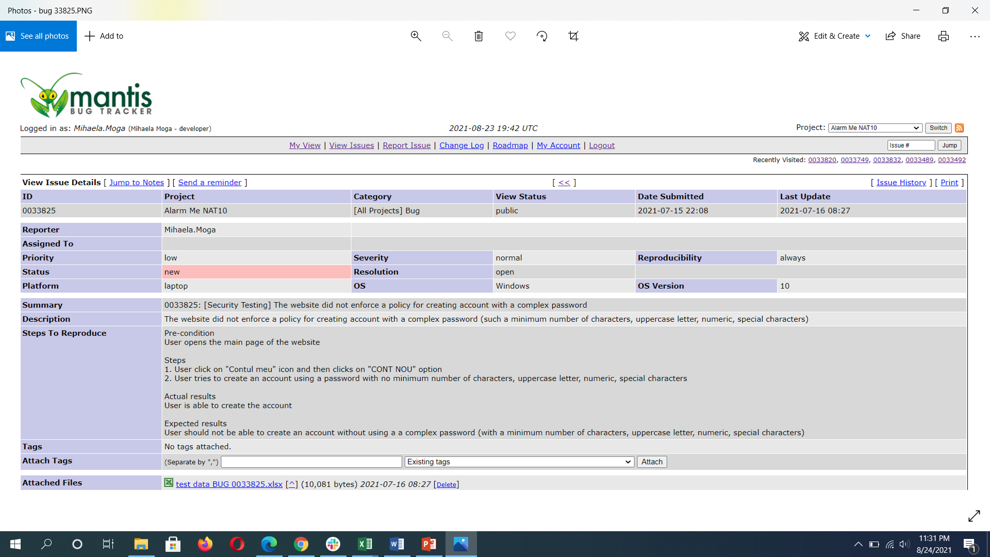
Bug 33825 – severity: normal

Slide 14
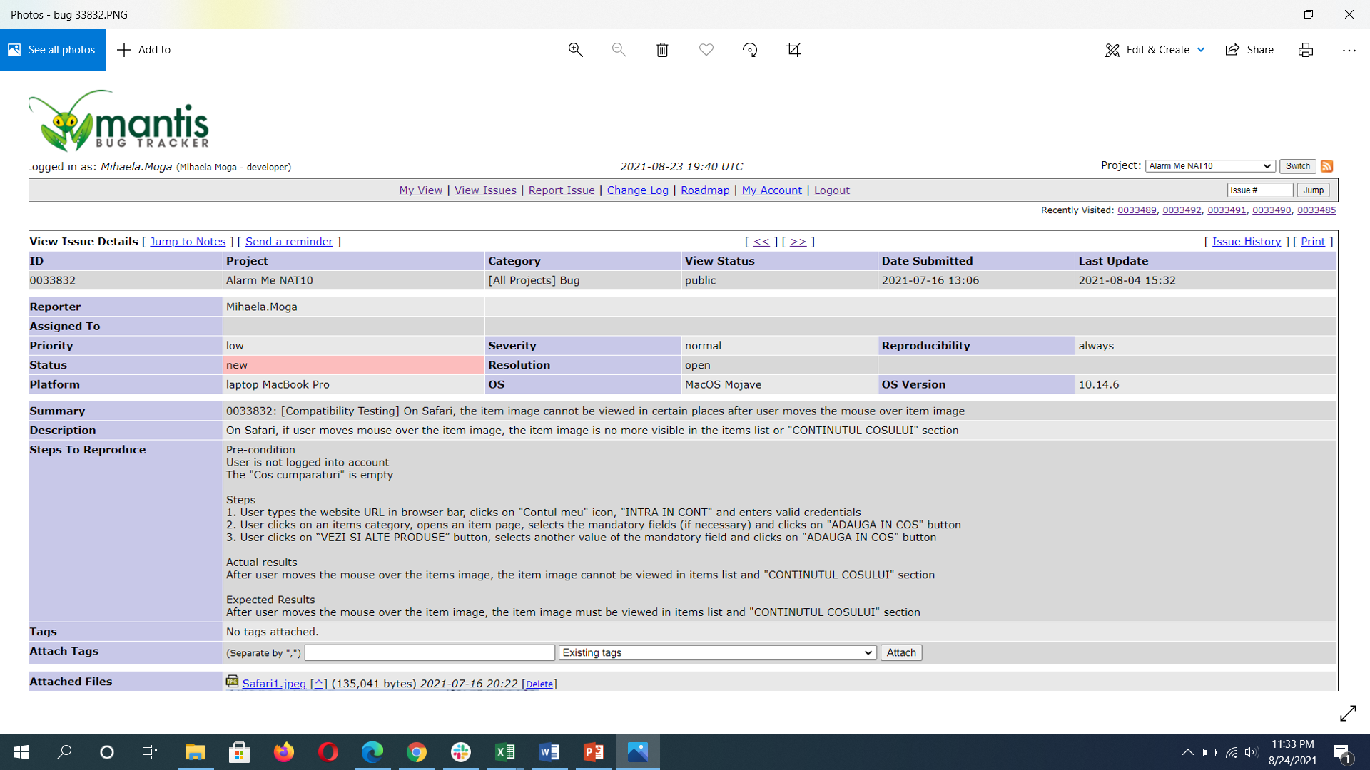
Bug 33832 – severity: normal

Slide 15
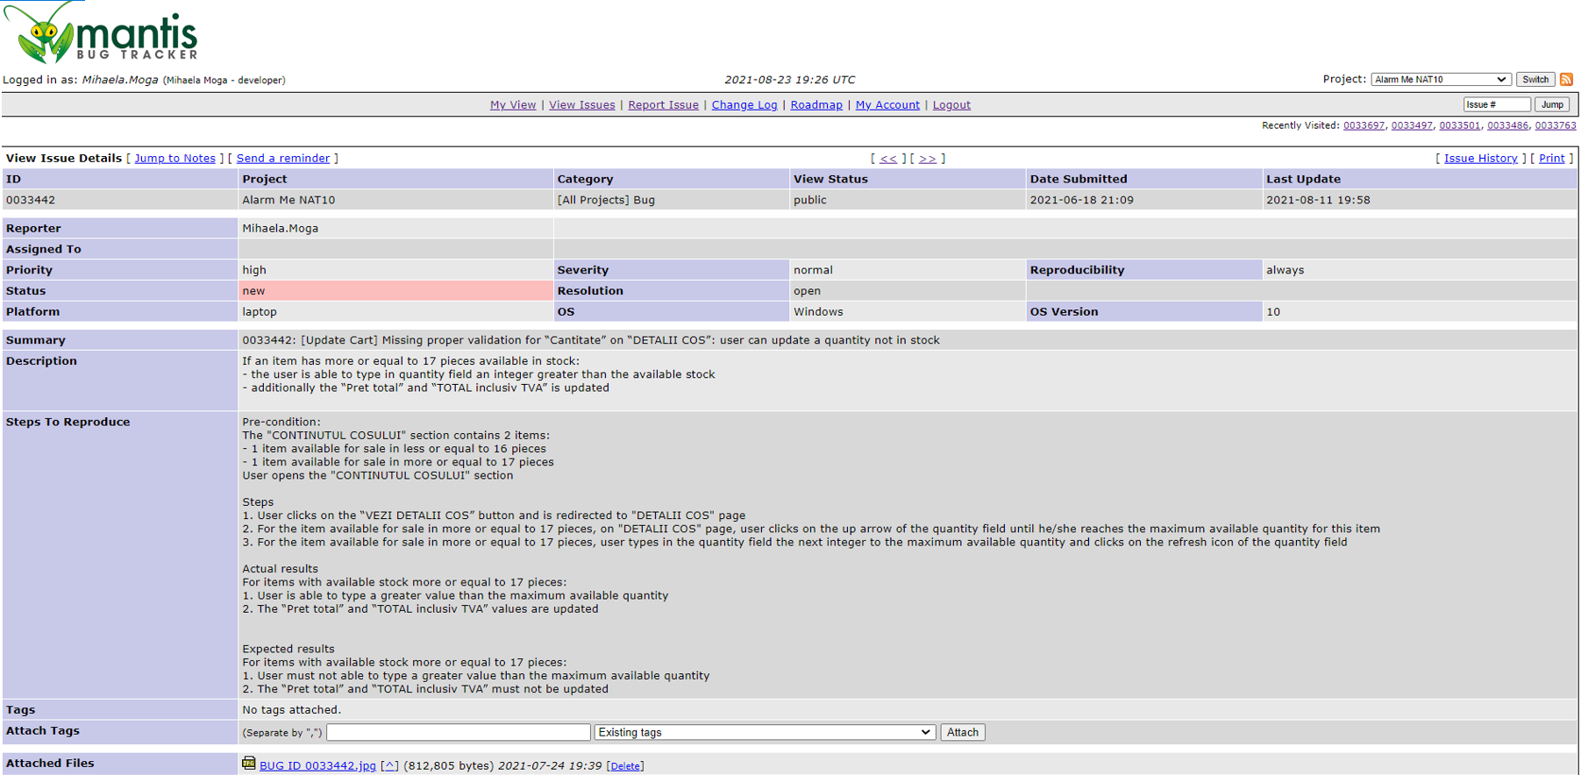
Bug 33442 – severity: normal

Slide 16
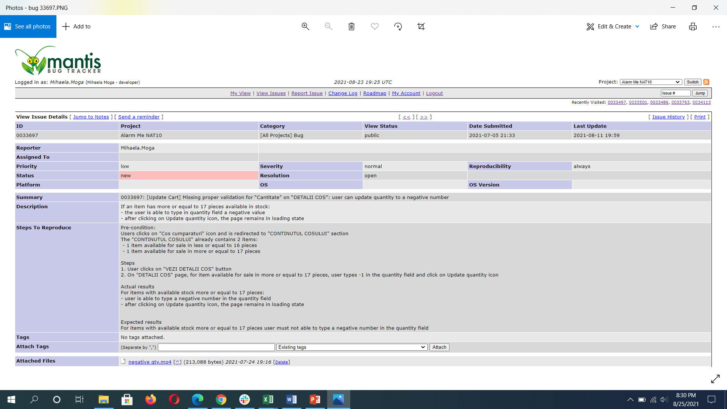
Bug 33697 – severity: normal

Slide 17
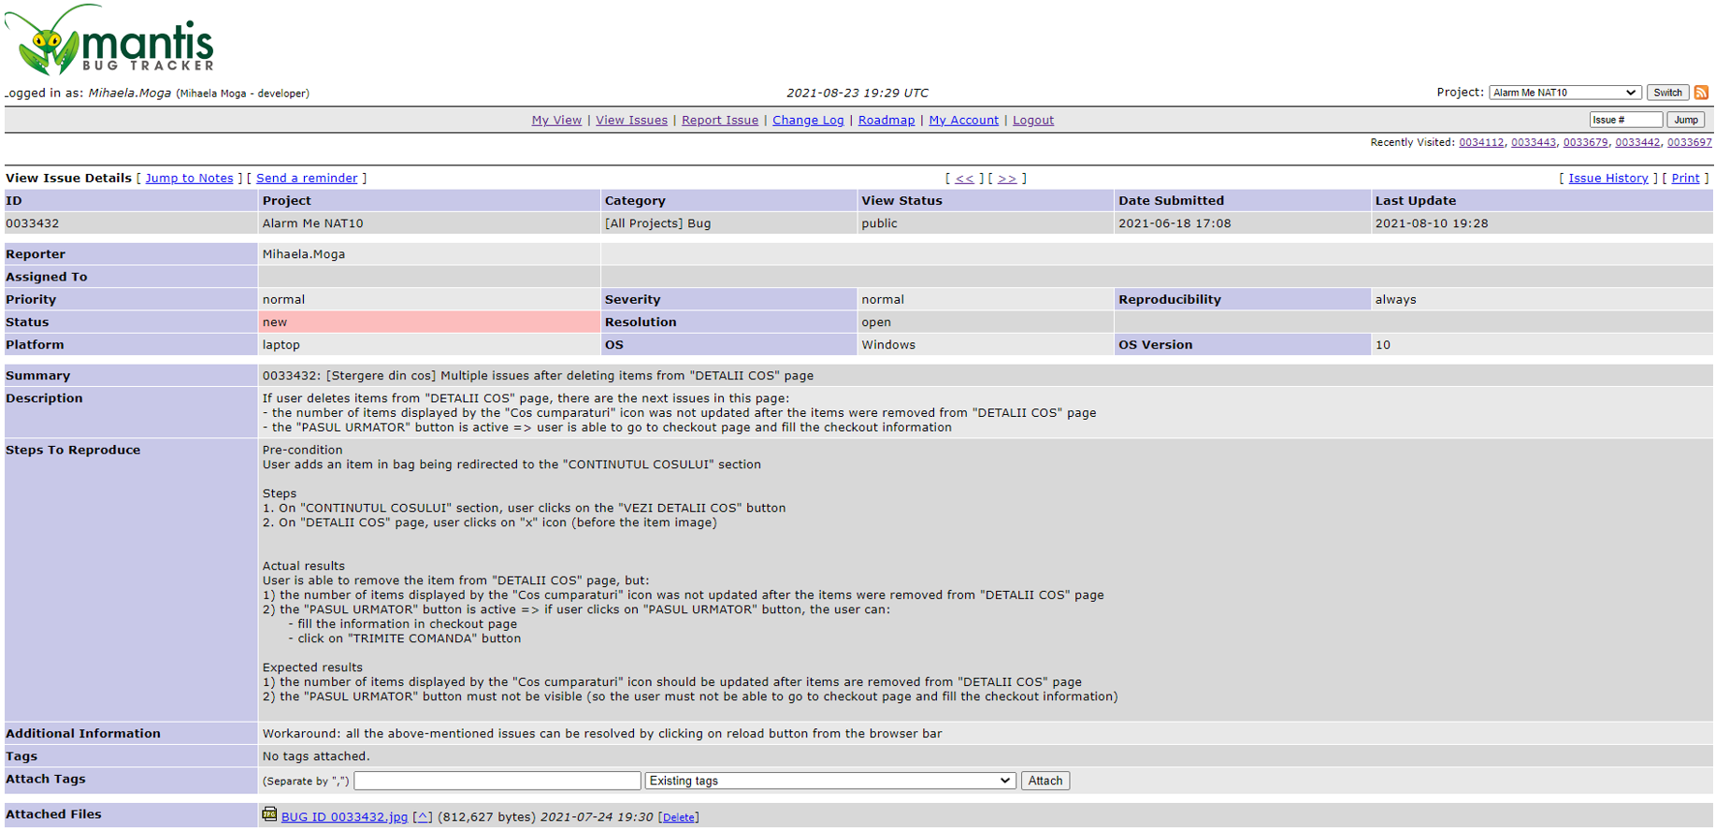
Bug 33432 – severity: normal

Slide 18
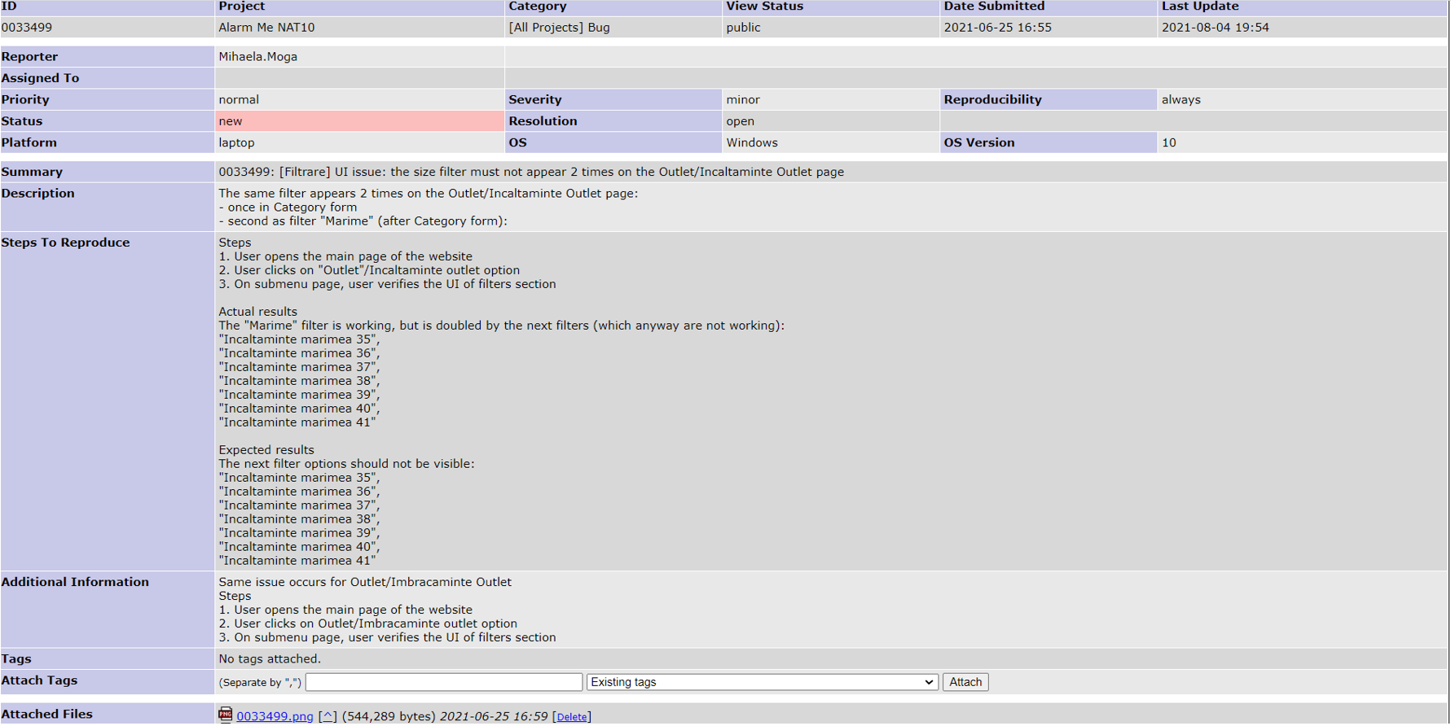
Bug 33499 – severity: minor

Slide 19
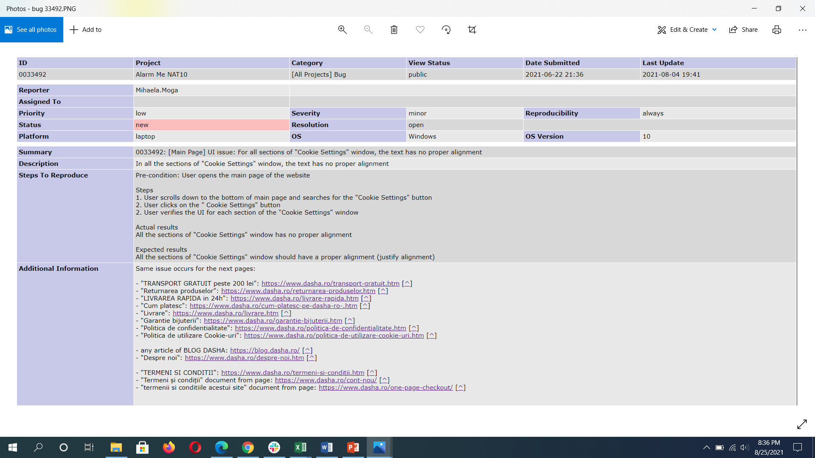
Bug 33492 – severity: minor

Slide 20
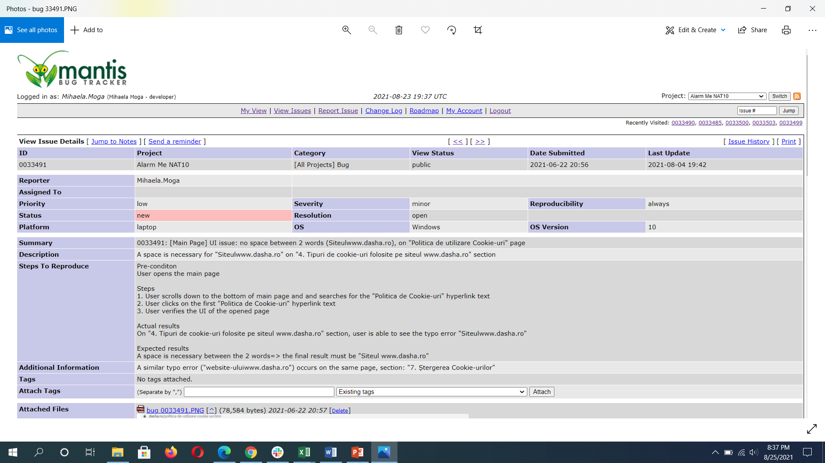
Bug 33491 – severity: minor

Slide 21
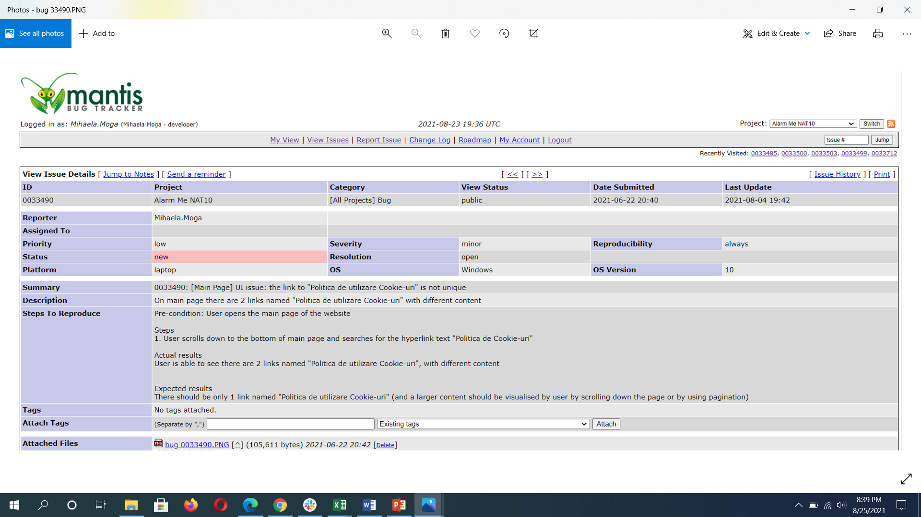
Bug 33490 – severity: minor

Slide 22
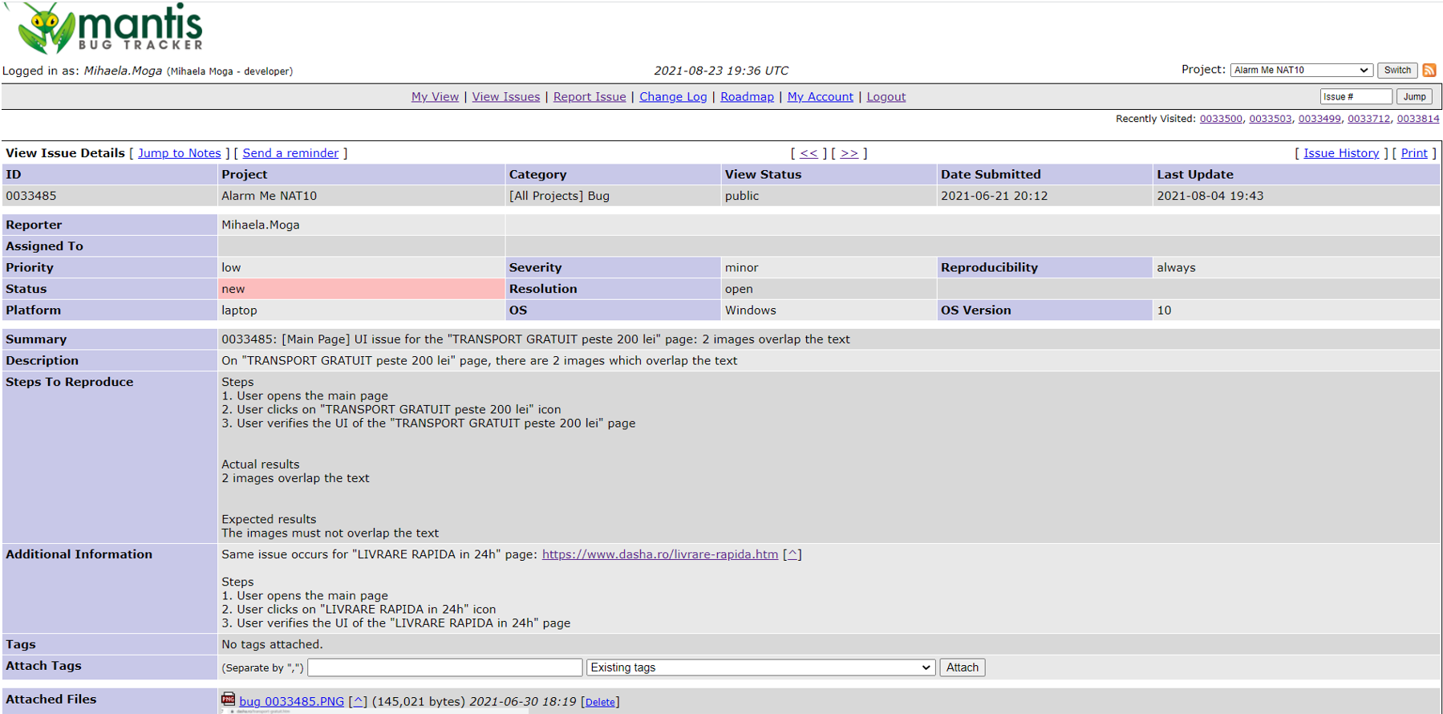
Bug 33485 – severity: minor

Slide 23
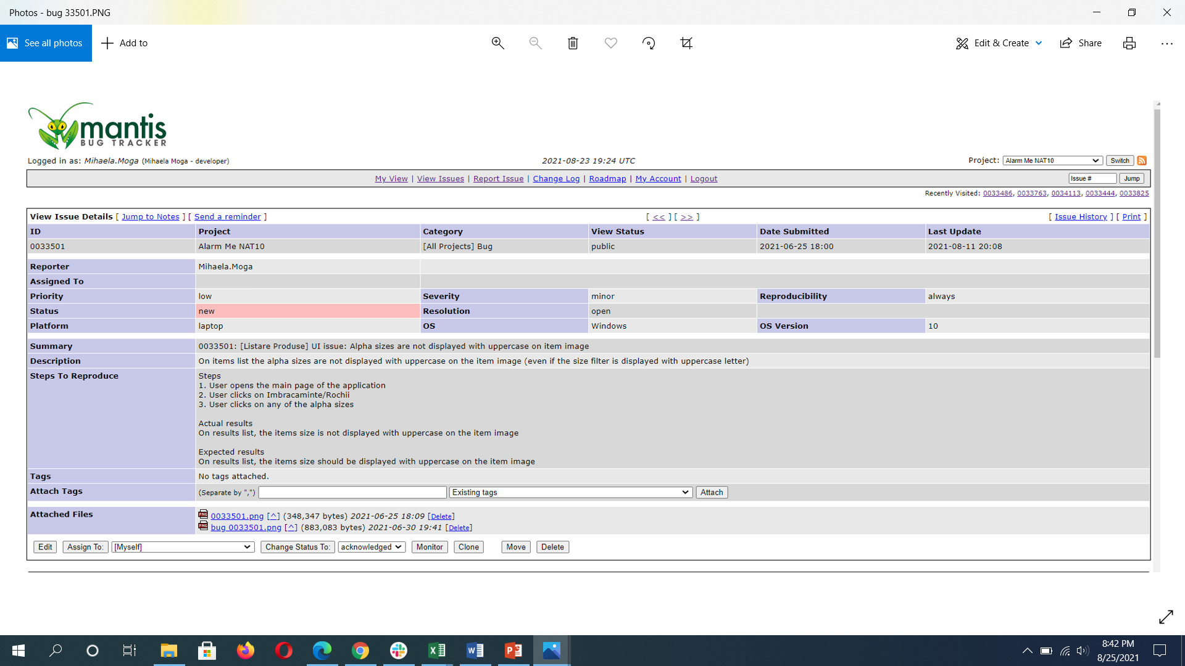
Bug 33501 – severity: minor

Slide 24
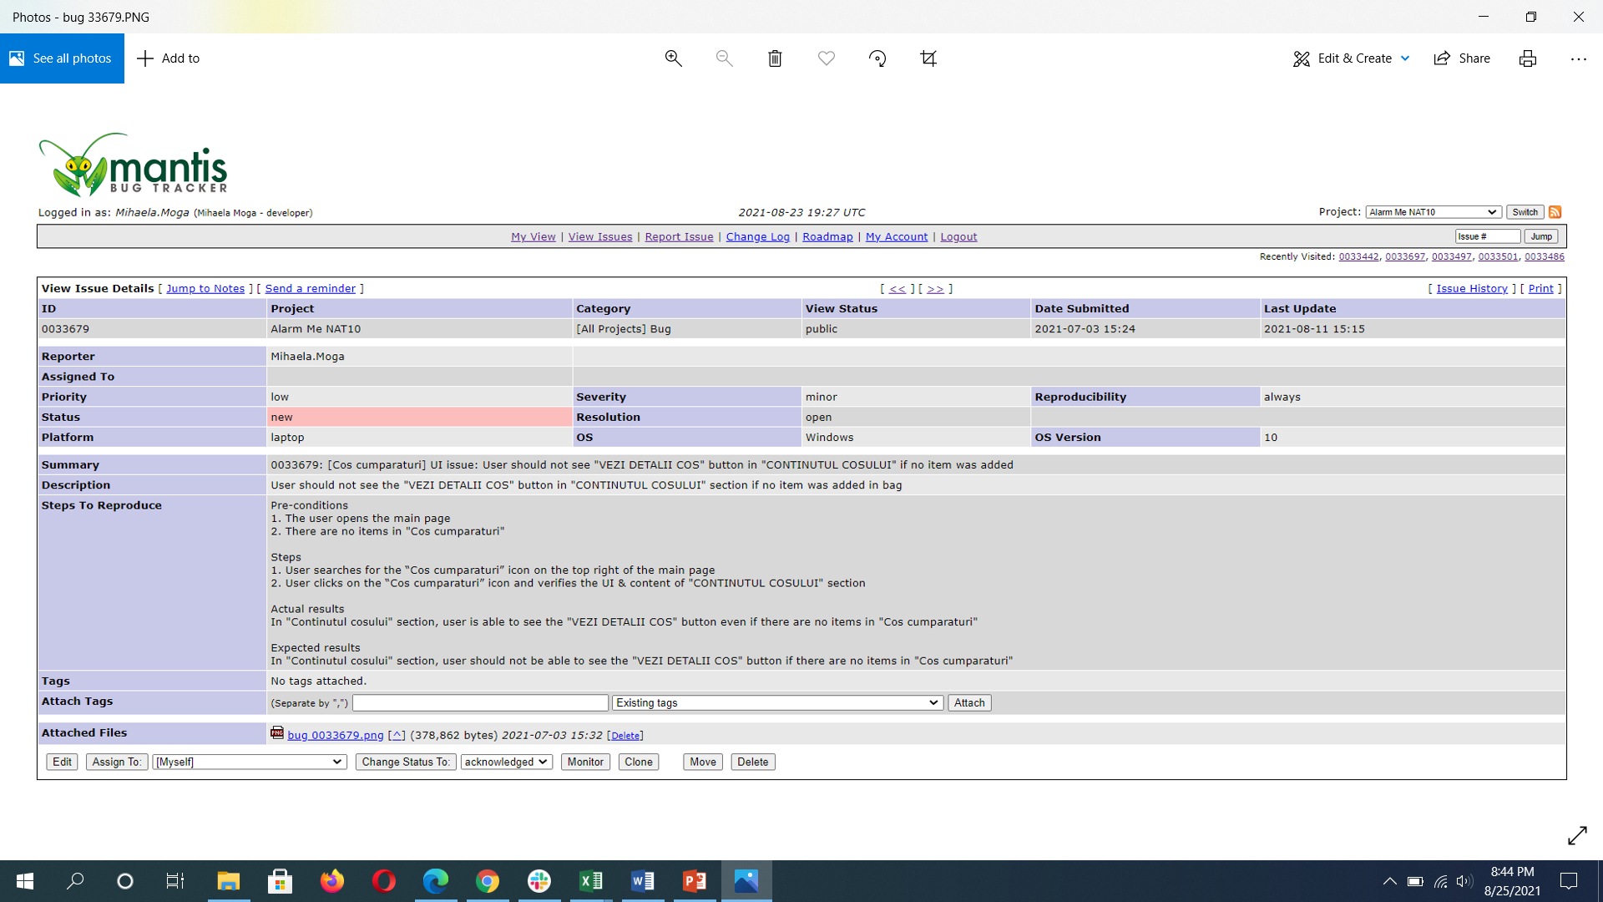
Bug 33679 – severity: minor

Slide 25
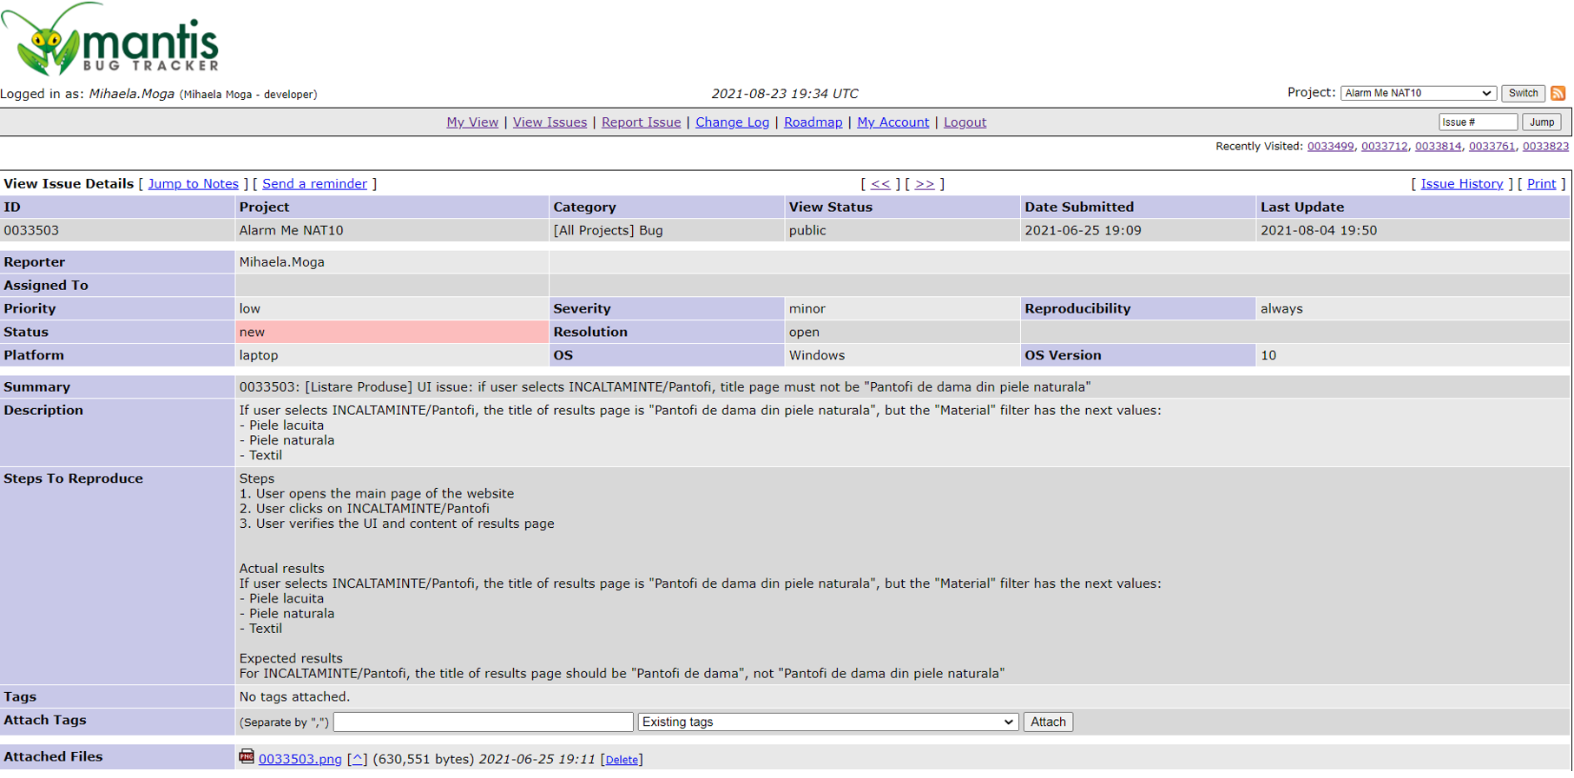
Bug 33503 – severity: minor

Slide 26
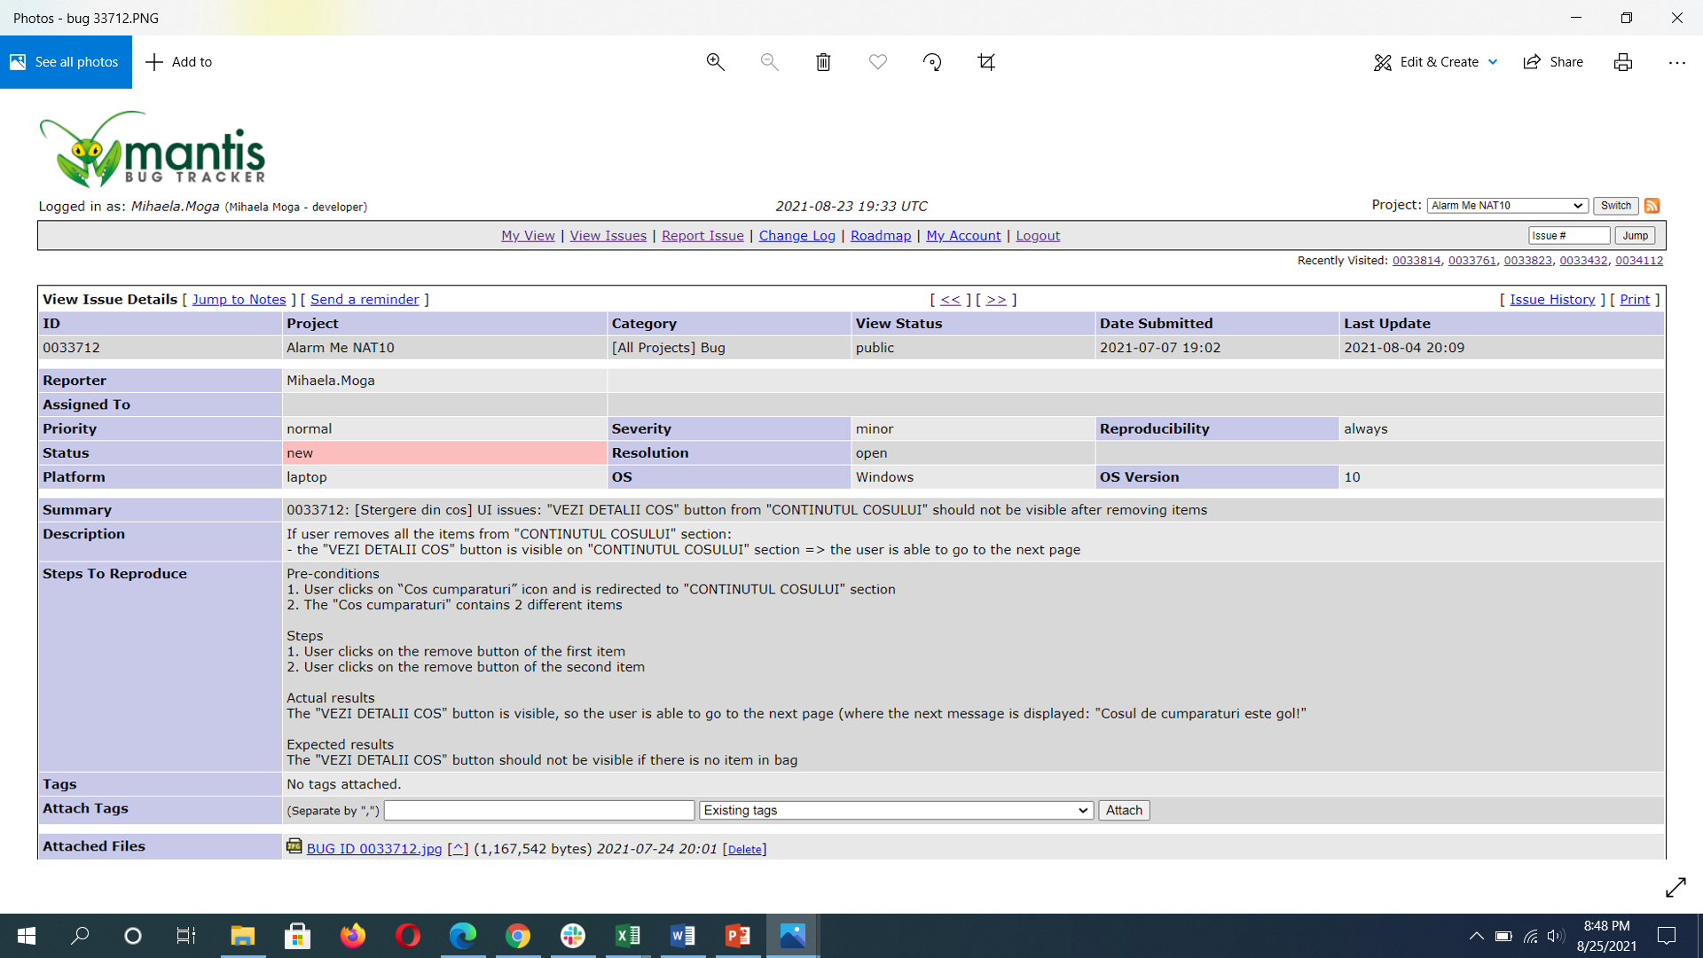
Bug 33712 – severity: minor

Slide 27
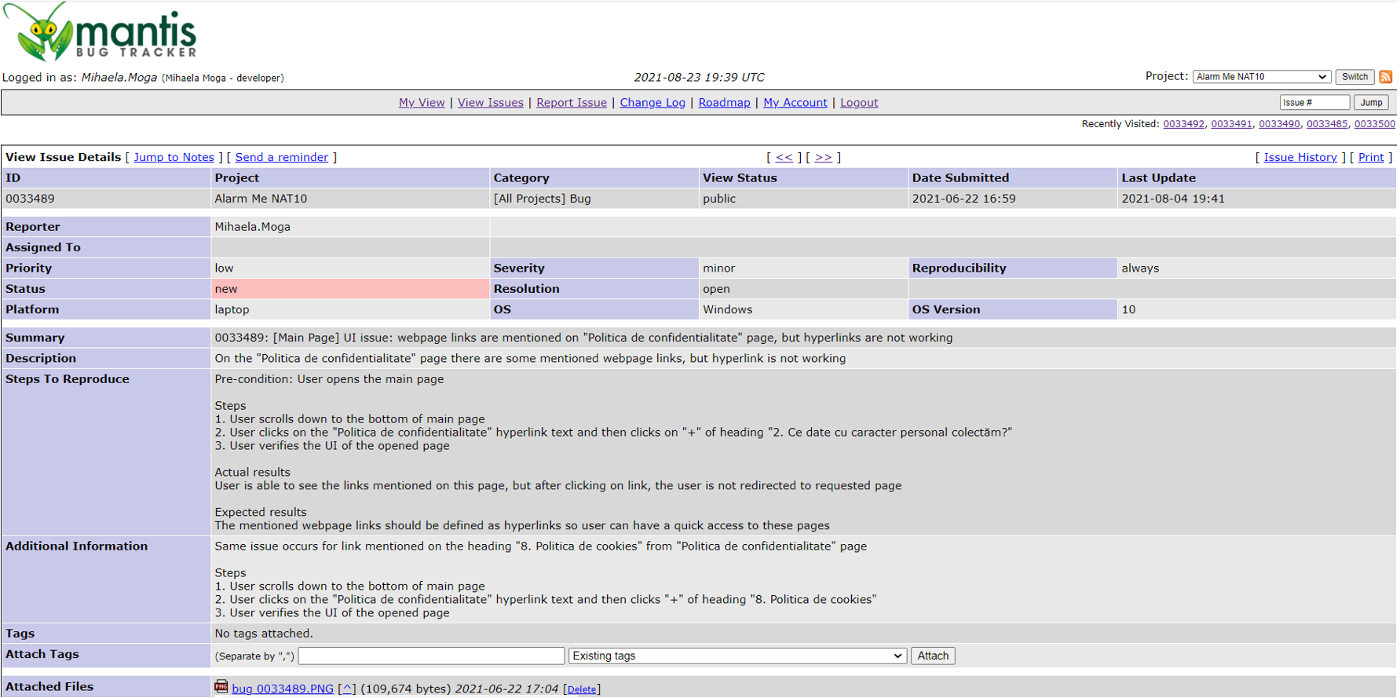
Bug 33489 – severity: minor

Slide 28
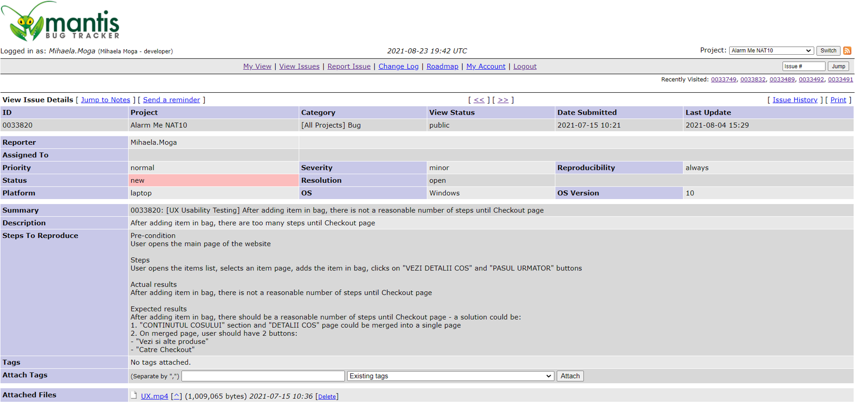
Bug 33820 – severity: minor

Slide 29
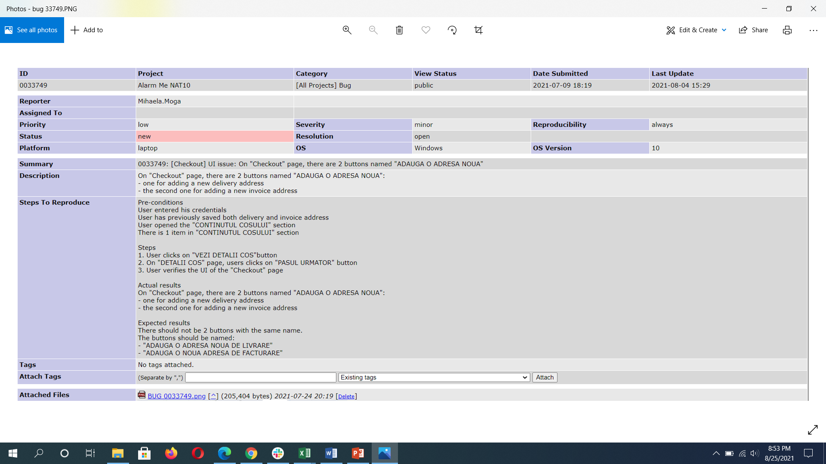
Bug 33749 – severity: minor

